Slide 1
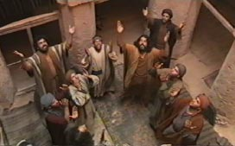
The Apostles See the Risen Jesus After Jesus was crucified, the apostles hid in a room with the door locked. They were afraid that the soldiers would arrest them because they were Jesus’ friends. Even after they heard Jesus had risen, they were still afraid.

Slide 2
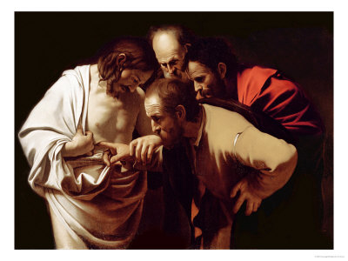
On Easter Sunday night the apostles were together in the room when something happened. All of a sudden Jesus stood among them and said “Peace be with you.” They were frightened because they thought they were seeing a ghost. But Jesus said, “Why are you frightened? Look at my hands and feet. It’s really me. Touch me and see for yourselves. A ghost doesn’t have flesh and bones, as you can see I have.” As he said this he showed them his hands and feet. The apostles were so full of joy that they could hardly believe it was really true! So Jesus said to them, “Have you anything here to eat?” They gave him a piece of baked fish, which he took and ate in front of them.

